Slide 1
Deep CNN for breast cancer histology Image Analysis
Honghao Zheng

Slide 2
Background
In Recent decades:
Improved and highly incidence of cancer, breast cancer is one of most common cancer diagnosed in women.
The improvement and advance in Machine learning make it as a efficient aid tool in medical field. Moreover, CNN is the most popular hot model in the medical AI.

Slide 3
Dataset
400 H&E（hematoxylin and eosin) stain images (2048 × 1536 pixels). All the images are digitized with the same acquisition conditions, with a magnification of 200 × and pixel size of 0.42 µm × 0.42 µm generated by the microscope.
Stain Images label as 4 classification: normal(A), benign(B), in-situ cancer(C), invasive cancer(D).

Slide 4
Overfit problem
If we just trained only 400 images in the deep CNN architecture like VGG, Inception, ResNet, which consist millions of parameters, it would lead to overfit.
The fine-tunning method works not very well..
How to solve it ?

Slide 5
New Idea
1st setup: unsupervised learning feature extraction, trained general dataset ImageNet by Deep CNN VGG-16. Before training, sparse coding on original image is pre-processing job.
2nd setup: use LightGBM implementing gradient boosted trees for supervised classification.

Slide 6
Pre-processing and encoding

Slide 7
Unsupervised Training

Slide 8
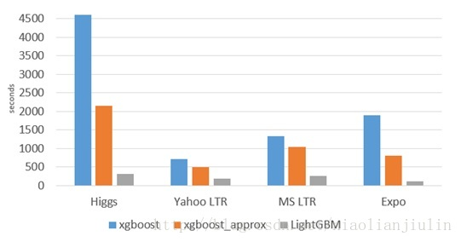
lightGBM——gradient boosting framework
Faster training speed and higher efficiency.
Lower memory usage.
Better accuracy.
Support of parallel and GPU learning.
Capable of handling large-scale data.

Slide 9
Training in LightGBM
10 stratified fold to preserve class distribution
Augmentation making the dataset*300.
To prevent leakage, all descriptor form a data have to be in same fold.
For each combination of the encoder, crop size and scale we train 10 gradient boosting models with 10-fold cross-validation
For the test data, similarly extract 50 descriptors for each image and use them with all models trained for particular patch size and encoder

Slide 10
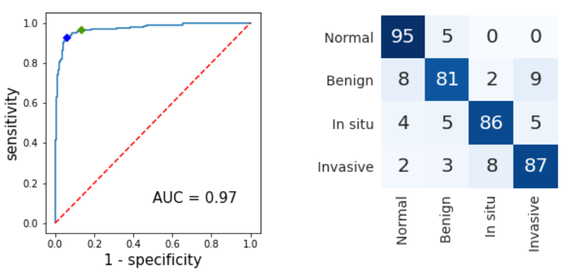
Result
10 fold stratified cross validation
Left: non-carcinoma vs. carcinoma classification, ROC. 96.5% sensitivity at high sensitivity setpoint (green)
Confusion matrix, without normalization. Vertical axis - ground truth, horizontal - predictions.

Slide 11
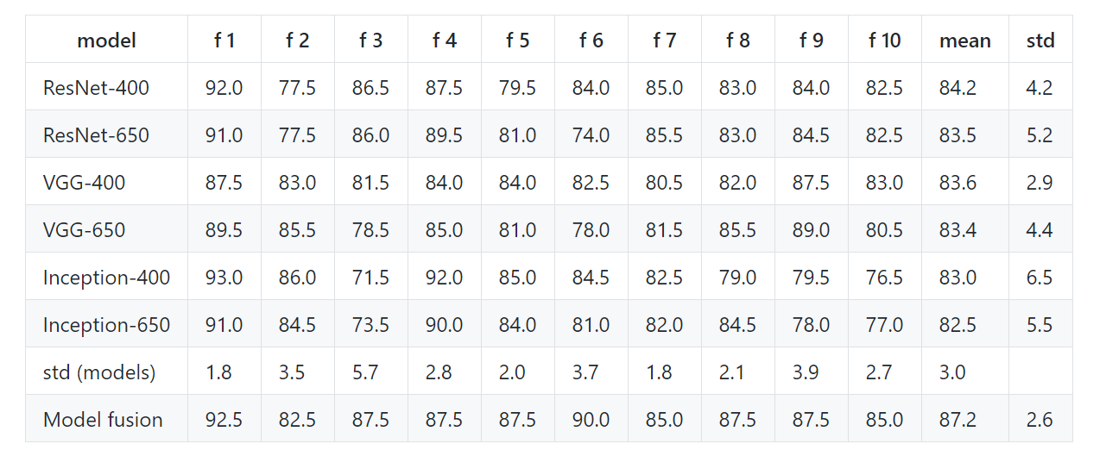
Result

Slide 12
Thank you

